Slide 1
Fire Safety
Merit Badge
Troop 344 and 9344
Pemberville, OH
Helping you develop the knowledge and the skills necessary to prevent and to survive fires and burns.

Slide 2
Fire Safety Merit Badge Requirements
Do the following:
Demonstrate the technique of stop, drop, cover, roll, cover your face, and cool. Explain how burn injuries can be prevented.
List the most frequent causes of burn injuries.
Explain how to safely store flammable and combustible liquids. Describe the options available for safely disposing of unwanted hazardous substances in your community.

Slide 3
Fire Safety Merit Badge Requirements
Explain the concept of fire and name the parts of the fire tetrahedron. Name the by-products of combustion. Describe the life cycle of a fire.
Name the most frequent causes of fire in the home and give examples of ways they can be prevented. Include a discussion about fires caused by smoking in the home, cooking, candles, fireplaces, and electrical appliances.

Slide 4
Fire Safety Merit Badge Requirements
Do the following:
Explain the four classifications of fire origin (accidental, natural, incendiary, or undetermined) and give an example of each.
Describe how a fire classified as incendiary might lead to criminal prosecution of a person charged with arson.
Explain some of the social, economic and environmental consequences that result from incendiary fires that damage or destroy structures and wildlands.

Slide 5
Fire Safety Merit Badge Requirements
List the actions and common circumstances that cause seasonal and holiday-related fires. Explain how these fires can be prevented.

Slide 6
Fire Safety Merit Badge Requirements
Conduct a home safety survey with the help of an adult. Then do the following:
Draw a home fire-escape plan, create a home fire-drill schedule, and conduct a home fire drill.
Identify the location of all smoke alarms in your home and confirm that none are more than 10 years old. Test each smoke alarm and demonstrate regular maintenance of a smoke alarm.
Explain what to do when you smell natural gas and when you smell smoke.
Explain how you would report a fire to have the fire department respond.

Slide 7
Fire Safety Merit Badge Requirements
Conduct a home safety survey with the help of an adult. Then do the following:
Explain what fire safety equipment can be found in public buildings.
Explain who should use fire extinguishers and when these devices can be used.
Explain how to extinguish a stovetop pan fire.
Explain what fire safety precautions you should take when you are in a public building.

Slide 8
Fire Safety Merit Badge Requirements
Do the following:
Demonstrate lighting a match safely, the proper way to extinguish it and to dispose of it.
Demonstrate the safe way to start a charcoal fire.
Demonstrate how to safely light a candle. Discuss with your counselor how to safely use candles.
Explain the difference between combustible and noncombustible liquids and between combustible and noncombustible fabrics.

Slide 9
Fire Safety Merit Badge Requirements
Do the following:
Describe for your counselor the safe way to refuel a liquid fueled engine, such as a lawn mower, weed eater, outboard motor, farm machine, or automobile with fuel from an approved gasoline container.
Demonstrate the safety factors, such as proper ventilation, for auxiliary heating devices and the proper way to fuel those devices.

Slide 10
Fire Safety Merit Badge Requirements
Do the following:
Explain the costs associated with outdoor and wildland fires and how they can be prevented.
Demonstrate setting up and putting out a cooking fire.
Demonstrate using a camp stove and lantern.
Explain how to set up a campsite safe from fire.
Visit a fire station. Identify the various types of fire trucks and describe the functions of each. Find out about the fire prevention activities in your community during your visit.

Slide 11
Fire Safety Merit Badge Requirements
Determine if smoke detectors are required in all dwellings within your municipality. If so, explain which specific types are required. Tell your counselor what type of smoke detectors your house has or needs.
Choose a fire safety-related career that interests you and describe the level of education required and responsibilities of a person in that position. Tell why this position interests you.

Slide 12
Requirement 1
Do the following:
Demonstrate the technique of stop, drop, cover, roll, cover your face, and cool. Explain how burn injuries can be prevented.
List the most frequent causes of burn injuries.
Explain how to safely store flammable and combustible liquids. Describe the options available for safely disposing of unwanted hazardous substances in your community.

Slide 13
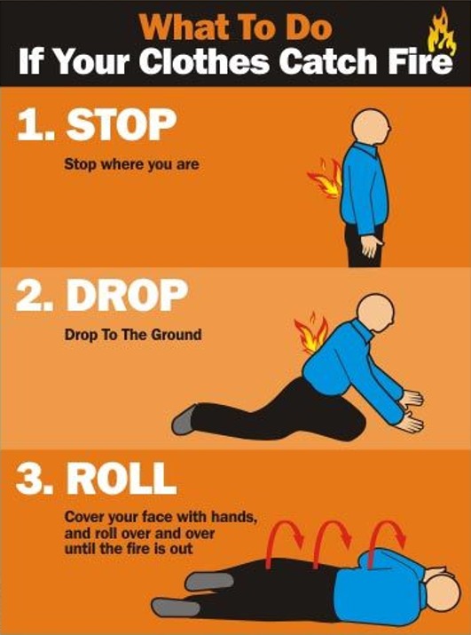
Requirement 1a
The Stop, Drop, Roll and Cool procedure should be used to extinguish flames and lessen burn injuries if your clothing catches fire.
If your clothes catch fire:
STOP immediately where you are.
DROP to the ground.
ROLL over and over and over, covering your face and mouth with your hands (this will prevent flames from burning your face and smoke from entering your lungs).
Roll over and over until the flames are extinguished.
COOL the burn with cool water for 10-15 minutes.
Get help, and if needed, see a doctor.

Slide 14
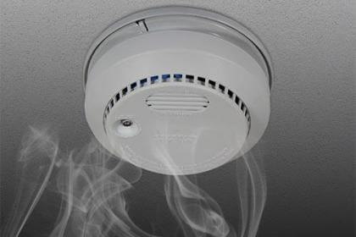
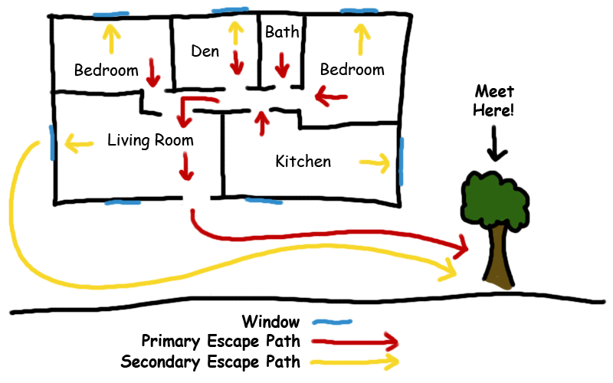
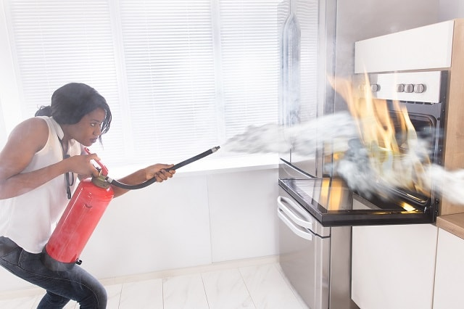
Requirement 1a
Fire and burn prevention and safety tips for your home:
Put smoke alarms in your home. Check them monthly. If they run on batteries, put in new batteries every 6 months.
Think about how you would get out of your home in a fire emergency. Make a family escape plan and have regular fire drills at home. Designate a meeting place outside your home in case there is a fire.
Have a professional inspect and clean your chimney and fireplace once a year.
Learn how and when to use a fire extinguisher. Keep one or more in your home.
Prevent chemical burns by wearing gloves and other protective clothing when you handle chemicals. Store chemicals, including gasoline, out of the reach of children.

Slide 15
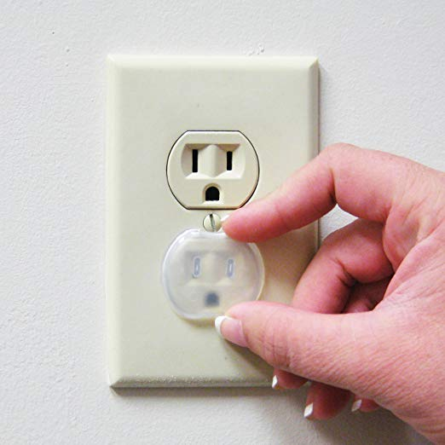
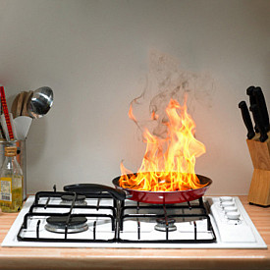
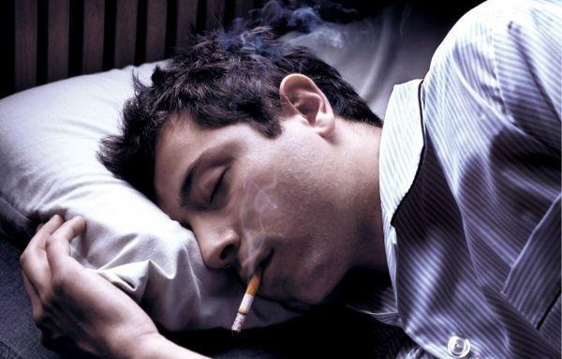
Requirement 1a
Fire and burn prevention and safety tips for your home (continued):
To prevent electrical burns, put covers on any electrical outlets that are within a child’s reach. Throw out electrical cords that are frayed or damaged.
Use space heaters carefully. Teach children to stay away from them.
Store matches and lighters in a locked cabinet, away from children.
Never leave candles unattended. Blow them out when you leave the room.
Don’t wear clothing with long, loose sleeves when you are cooking.
Cooking fires are the leading cause of house fires. Put out a small fire on a stove by sliding a lid over the flames.
If you smoke, don’t smoke in bed. Get rid of used cigarettes carefully. Fires caused by smoking materials are the leading cause of deaths in house fires.

Slide 16
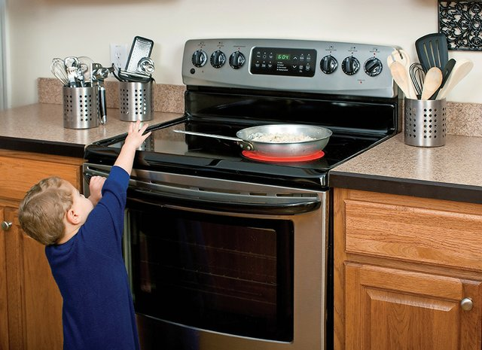
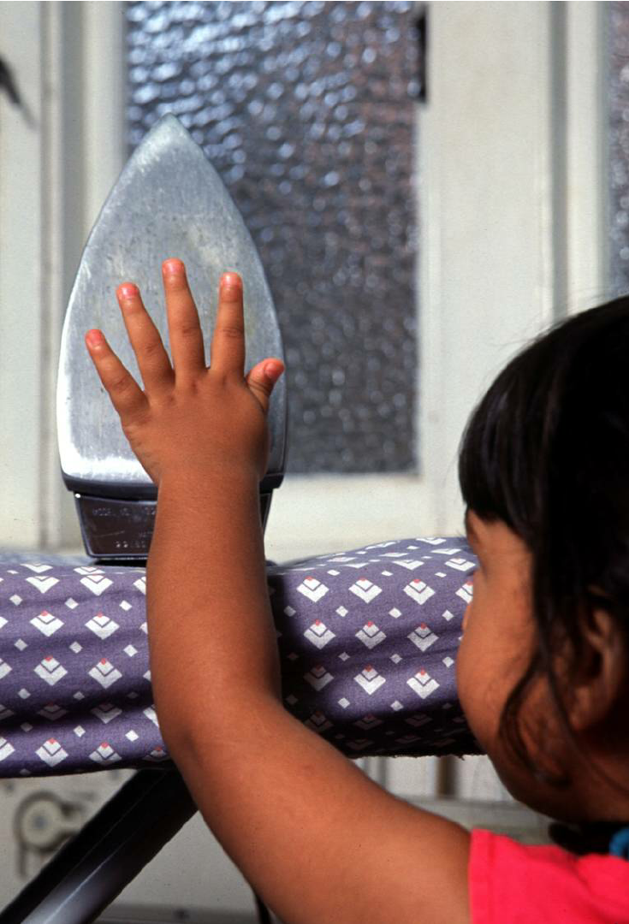
Requirement 1b
The most common place for a burn incident is in the home.
The most frequent causes of burn injuries are:
Contact with fire or flame – 46%
Scalding injuries – 32% (steam, hot bath water, spilled coffee).
Thermal burns – 8% (contact with hot objects like irons or ovens).
Electrical burns – 4%
Chemical burns – 3%
The remaining 7% are a combination of other causes, including sun burn, fireworks, inhalation.

Slide 17
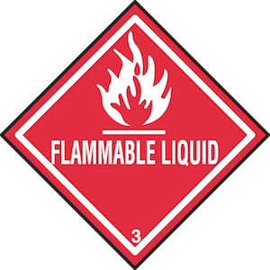
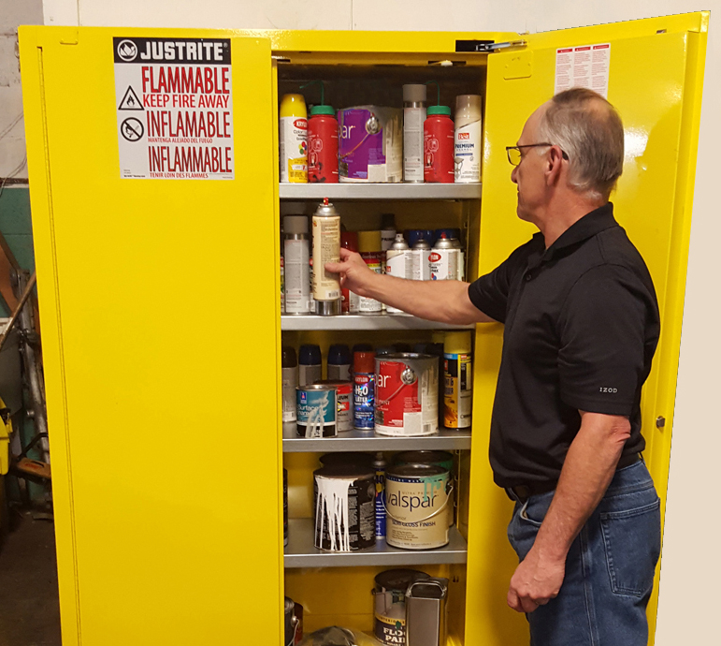
Requirement 1c
How To Store Flammable Liquids
Proper storage of your flammable liquids is essential because any liquid or vapor leaks can cause a fire in your home or business.
You should store the liquids in their original container if possible, or use a container made of the same material as the original container.
Make sure your containers are sealed, labeled, and secure in one area like your garage or storage shed.
Be aware of any possible leaks in your containers since a small leak can spread quickly.
Flammable and combustible liquids should be kept away from stairs, doorways, hallways, etc.
Protect yourself and others and keep your home or business safe by keeping flammable liquids out of reach from children and pets.

Slide 18
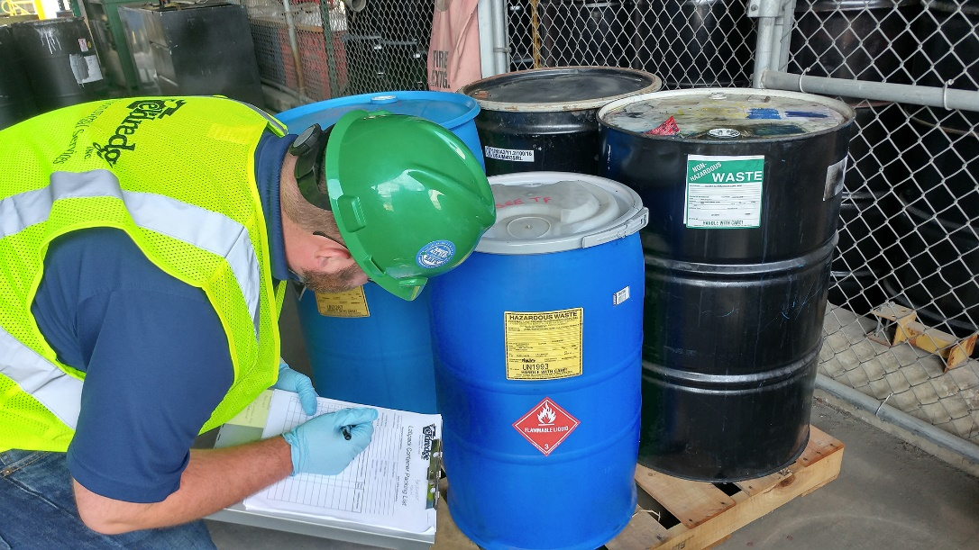
Requirement 1c
How To Dispose of Flammable Liquids
Never pour waste flammable liquids down sinks or drains.
The safest way to dispose of flammable liquids is to place them in the correct containers and label them immediately.
Keep them away from ignition sources.
Contact your local environmental, health, or solid waste agency to learn about permanent or periodic hazardous waste collections near you.

Slide 19
Requirement 1c
How To Dispose of Flammable Liquids
Never pour waste flammable liquids down sinks or drains.
The safest way to dispose of flammable liquids is to place them in the correct containers and label them immediately.
Keep them away from ignition sources.
Dispose of them through hazardous waste collection and disposal companies.

Slide 20
Requirement 2
Explain the concept of fire and name the parts of the fire tetrahedron. Name the by-products of combustion. Describe the life cycle of a fire.

Slide 21
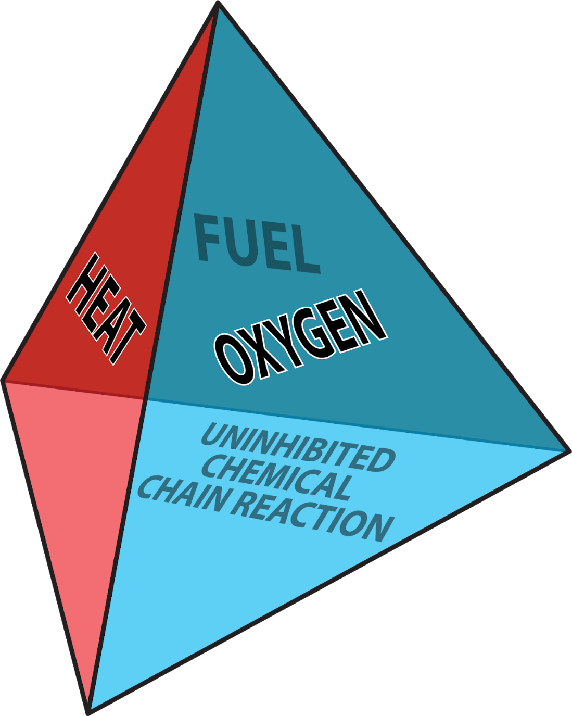
Requirement 2
The Fire Tetrahedron
Fires start when a flammable and/or a combustible material, in combination with a sufficient quantity of an oxidizer, such as oxygen gas, is exposed to a source of heat or ambient temperature above the flash point for the fuel/oxidizer mix, and is able to sustain a rate of rapid oxidation that produces a chain reaction.
Fire cannot exist without all of these elements in place and in the right proportions.
For example, a flammable liquid will start burning only if the fuel and oxygen are in the right proportions.
Once ignited, a chain reaction must take place whereby fires can sustain their own heat by the further release of heat energy in the process of combustion and may propagate, provided there is a continuous supply of an oxidizer and fuel.

Slide 22
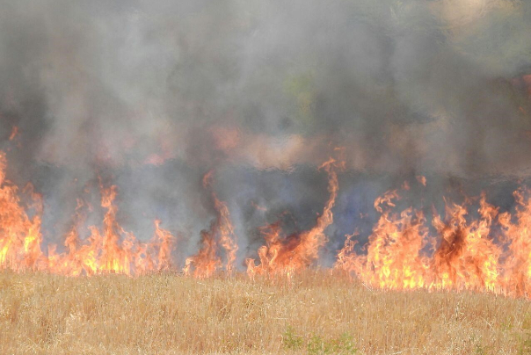
Requirement 2
When a fire burns, its products are light, heat, gases, and particles.
The heat from combustion is often hot enough that incandescent light in the form of either glowing or a flame is produced.
The most harmful gas produced by a fire is carbon monoxide; an odorless colorless, and tasteless gas that can be fatal when breathed.
The particles produced in a fire are called soot which is mostly carbon particles of incompletely burned fuel.
These particles combine with the gasses of the fire and make smoke.

Slide 23
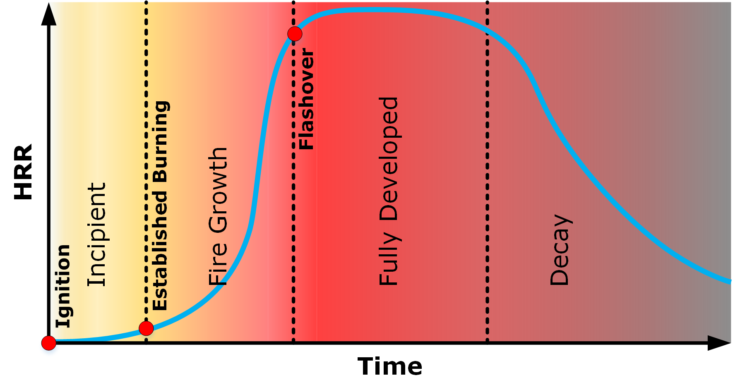
Requirement 2
The four stages of fire development are:
Incipient Stage - the first stage of the fire that occurs immediately after ignition and before the spread of the fire develops.
Fire Growth Stage - As this stage continues, the fire growth will be relatively quick and hard to control. In this stage, a flashover becomes highly likely as the room’s temperature increases.
Fully Developed Stage - The fire will peak and then begin to die back, traditionally due to a lack of fuel or oxygen.
Decay Stage - The final stage of the fire’s life cycle and will result in the fire ‘dying’ after it has consumed all the fuel and oxygen available.

Slide 24
Requirement 3
Name the most frequent causes of fire in the home and give examples of ways they can be prevented. Include a discussion about fires caused by smoking in the home, cooking, candles, fireplaces, and electrical appliances.

Slide 25
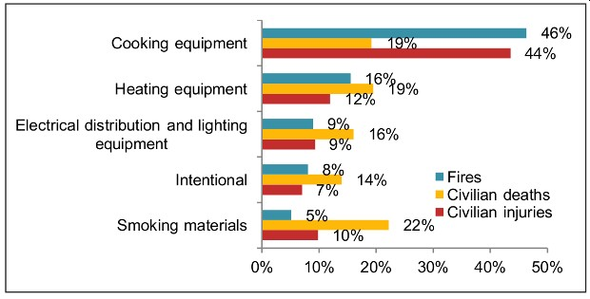
Requirement 3
The leading cause of home fires and related injuries is home-cooking equipment.
However, most fire-related deaths are from residential fires ignited by smoking materials such as cigarettes.
The leading cause of residential fire-related death and injury among children ages 9 and under is carelessness.

Slide 26
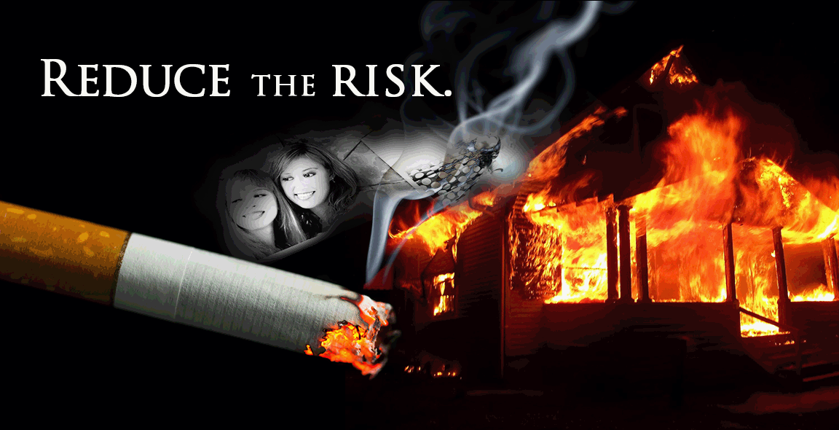
Requirement 3
Home Fires Started by Smoking
One in 20 home structure fires are started by smoking materials.
These fires cause almost one in four home fire deaths, one in 10 home fire injuries, and $476 million in direct property damage per year.
The leading area of origin for home smoking fires was an exterior balcony or open porch.
Almost half of the deaths are caused by fires that start in the living room and one-third of the deaths are caused by fires that begin in the bedroom.

Slide 27
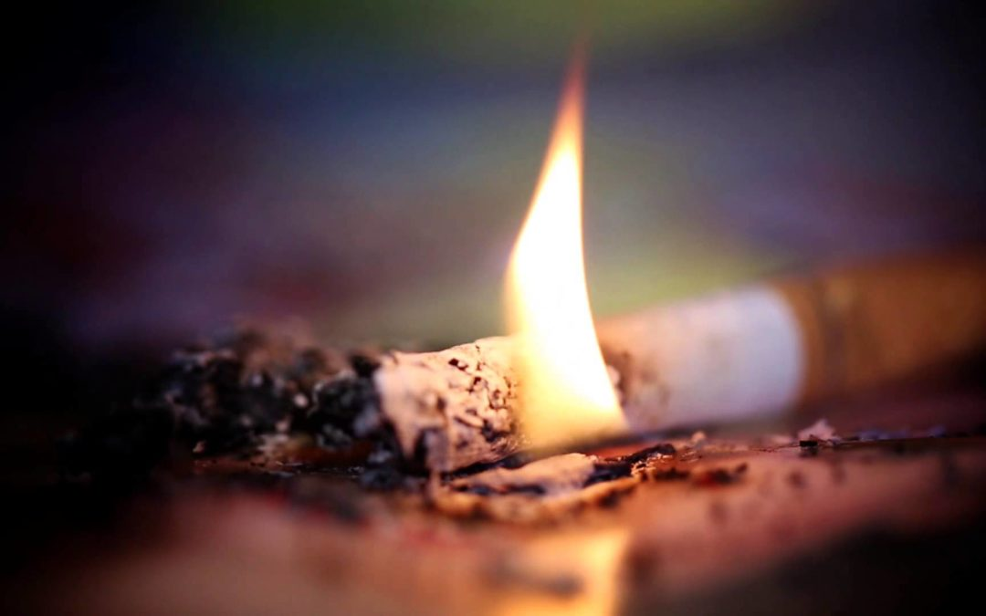
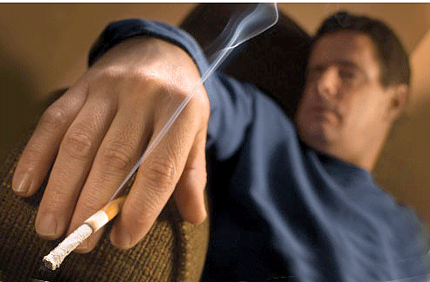
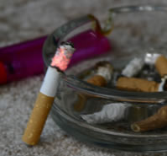
Requirement 3
It is best for your health in many ways to not smoke. If you must smoke:
Smoke outside – Many things in your home can catch on fire if they touch something hot like a cigarette or ashes. It is always safer to smoke outside.
Put cigarettes out all the way. Do This every time – Don’t walk away from lit cigarettes and other smoking materials. Put water on the ashes and butts to make sure they are really out before you put them in the trash
Be alert and do not smoke after taking medicine that makes you tired – You may not be able to prevent or escape from a fire if you are sleepy.
Never smoke around medical oxygen – Oxygen can explode if a flame or spark is near.
Never smoke in bed – Mattresses and bedding can catch on fire easily. Too often victims fall asleep with a lit cigarette.
Put your cigarette out in an ashtray or bucket with sand – Use ashtrays with a wide base so they won’t tip over and start a fire.

Slide 28
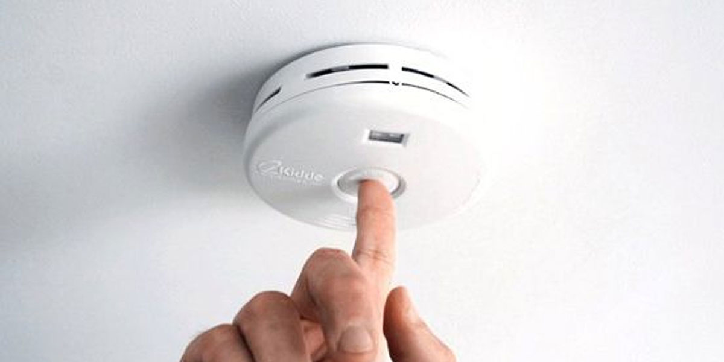
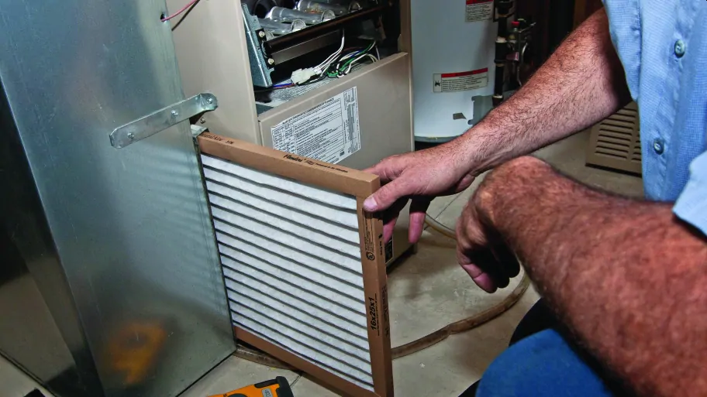
Requirement 3
10 ways to reduce the risk of house fires:
Test Your Smoke Alarms Regularly
The easiest way to avoid a house fire is by checking your smoke alarms regularly. There is a little button on it that you can press to test it. If it beeps weakly, then you need to change the batteries ASAP.
If a fire breaks out and it’s not working, tragedy can quickly occur as no one is alerted to evacuate.
Inspect All Your Heating Sources
If your heating sources aren’t working properly they could trigger a fire to happen. You should have them checked out annually by a professional.
Make sure your air filters are always cleaned out, and if you’re using a space heater – it needs to be positioned away from anything flammable. A fire can easily start from debris and dust being too close to a heat source so make sure you clean them regularly.

Slide 29
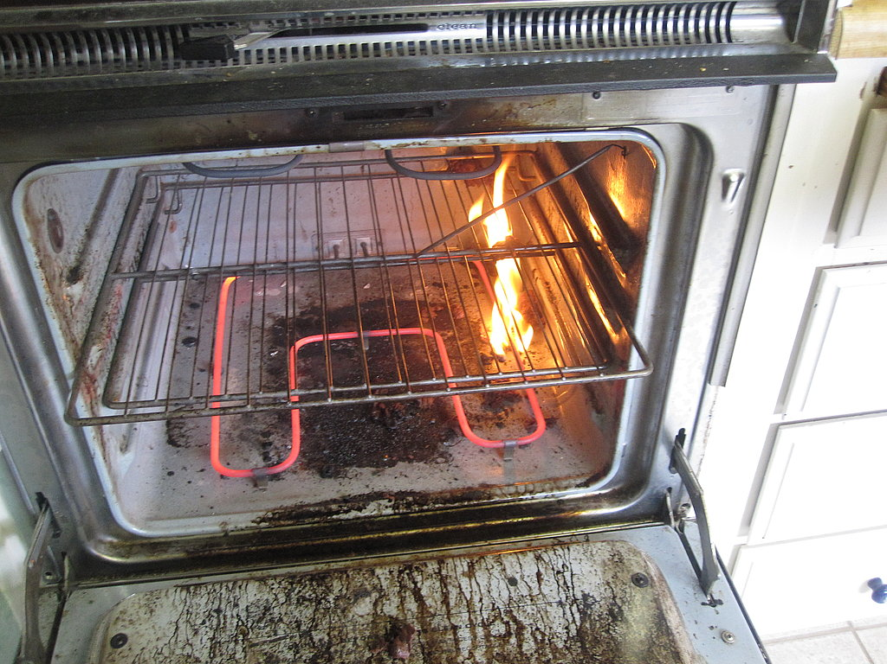
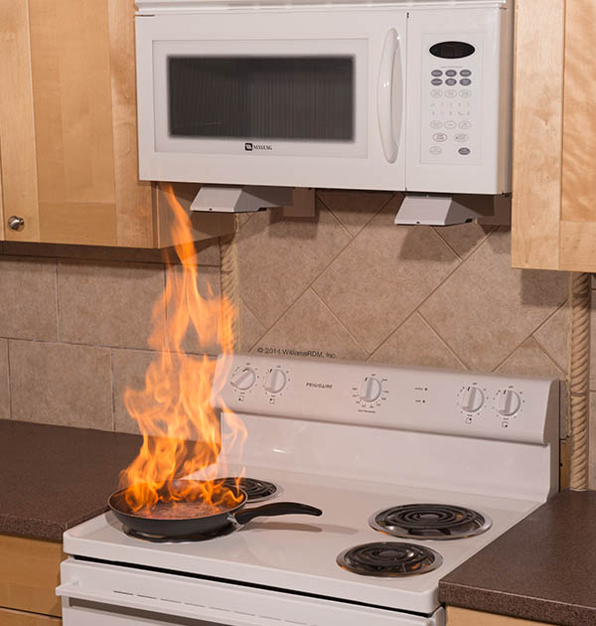
Requirement 3
10 ways to reduce the risk of house fires:
Keep Your Stove and Oven Clean
Don’t worry, the stove didn’t randomly combust because of your cooking. It most likely happened because forgotten food particles on the burner got too hot. Food particles aren’t the only thing that could cause this to happen.
If your curtains hang a little too close to the stove, they can catch fire. If you leave a dish towel or cookbook on a burner that you forgot was still hot, they can catch fire.
Don’t Leave Your Kitchen
A few seconds is all it takes for a fire to break out. This is why you never want to leave cooking food unattended. If you have to leave the kitchen for any reason, turn off that pot of boiling noodles first.
If for whatever reason you can’t turn off the oven, call someone into the kitchen to watch the food until you get back.

Slide 30
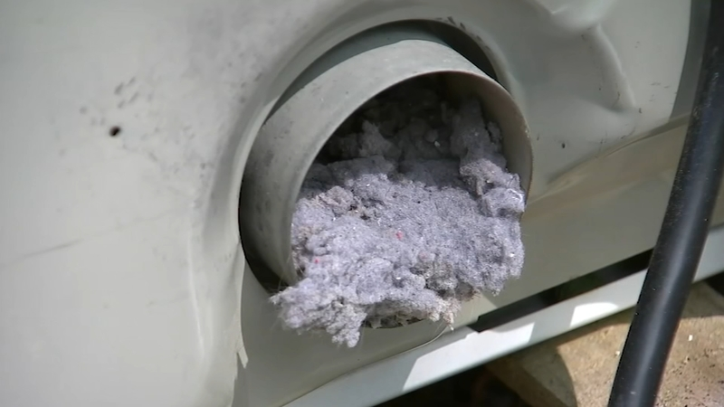
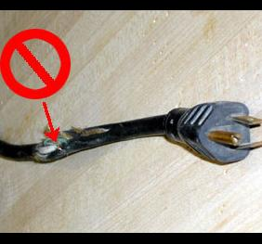
Requirement 3
10 ways to reduce the risk of house fires:
Always Check Your Dryer
Depending on what type of dryer you have, they need to be inspected on a yearly basis. We all get in a hurry when we’re doing our chores but, don’t forget to clean out your lint trap every time you put in a new load of laundry.
You also want to check behind the machine to make sure lint or little clothing items like socks didn’t manage to get back there.
Maintain All Cords
Before you plug something in, make sure that the cord hasn’t been frayed or chewed. If you do notice damaged wires, replace them as soon as possible because this is a huge fire hazard.
Also, check your cord placement. They tend to get hot so you want to avoid running them under a rug or between your wall and furniture.

Slide 31
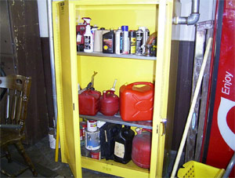
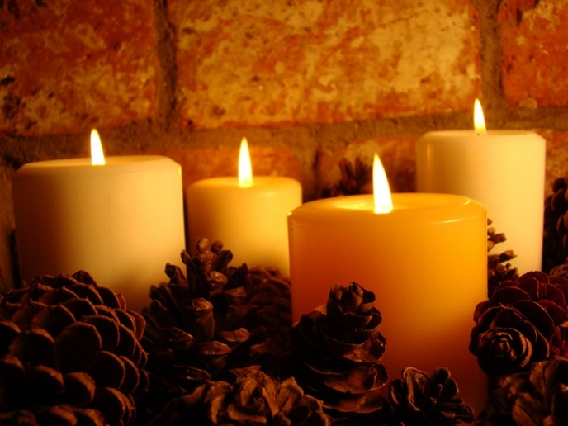
Requirement 3
10 ways to reduce the risk of house fires:
Properly Store Flammable Products
Household cleaners and common cosmetic items like hairspray and shaving cream can be hazardous. If they are exposed to a large heat source, they can combust. You want to keep them away from space heaters, and store them safely in a cool area.
Practice Caution with Candles
Everyone loves scented candles, especially around the holidays – but if you don’t use them carefully, they could cause a fire. Make sure you put them out before you exit a room and keep them far away from blankets or other objects.
If you feel yourself drifting off to sleep, get up and blow the candle out. Never put them on an uneven surface like carpet, because it’s too easy for them to tip over. If you have pets, make sure lit candles stay out of their reach.

Slide 32
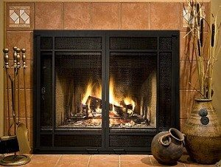
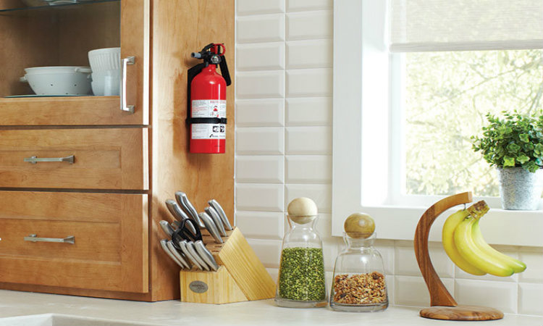
Requirement 3
10 ways to reduce the risk of house fires:
Be Careful with Your Fireplace
You don’t want any stray sparks to escape so you need to make sure you have a door between the flames and your flooring. It goes without saying, but never leave the room when the fireplace is going.
When you throw the ashes away, make sure you’ve given them more than enough time to cool down. Dispose of them in a metal container that is designated just for the ashes.
Keep Fire Extinguishers Around
Fire extinguishers are your best defense weapon when a fire breaks out. You want to make sure you have one in every room that is a potential threat, such as the kitchen.
Every family member should know how to use an extinguisher so if a fire does happen, it can be put out as fast as possible.

Slide 33
Requirement 4
Do the following:
Explain the four classifications of fire origin (accidental, natural, incendiary, or undetermined) and give an example of each.
Describe how a fire classified as incendiary might lead to criminal prosecution of a person charged with arson.
Explain some of the social, economic and environmental consequences that result from incendiary fires that damage or destroy structures and wildlands.

Slide 34
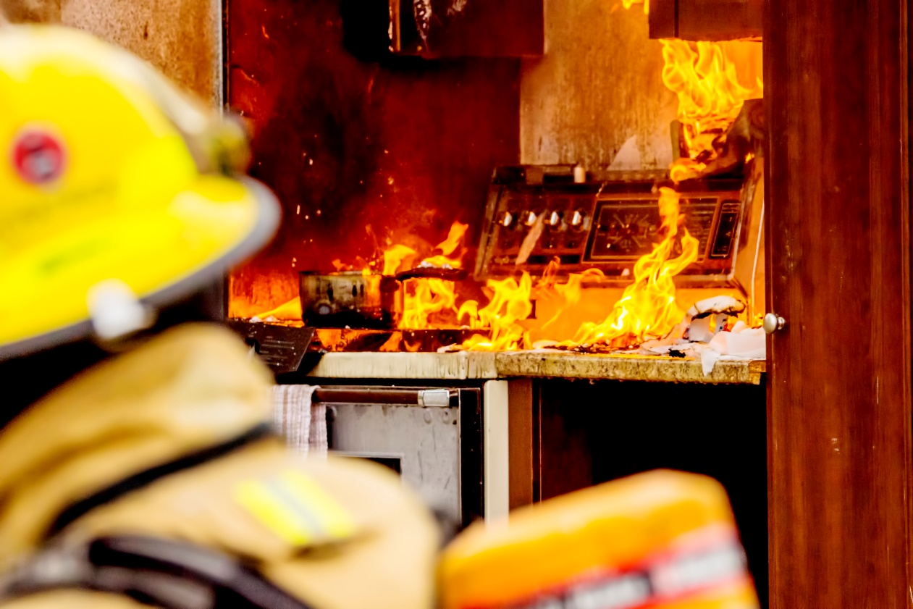
Requirement 4a
Accidental Fire Cause
When fire is not the result of a deliberate act.
Includes friendly fires ignited deliberately but that become hostile.
e.g., brush or trash fires that spread.

Slide 35
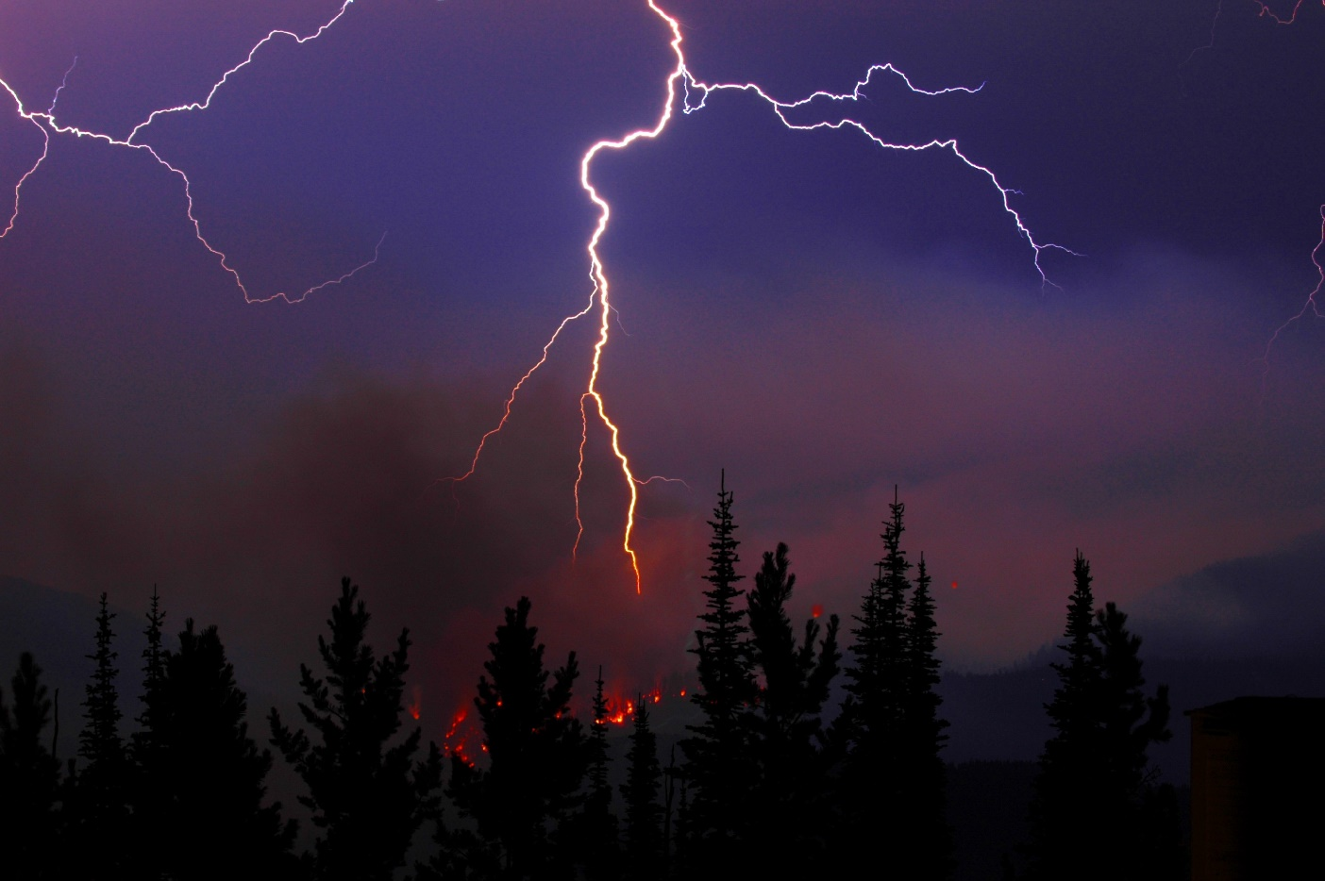
Requirement 4a
Natural Fire Cause
When fire ignites without human intervention
Includes fires from:
Lightning
Wind
Earthquakes

Slide 36
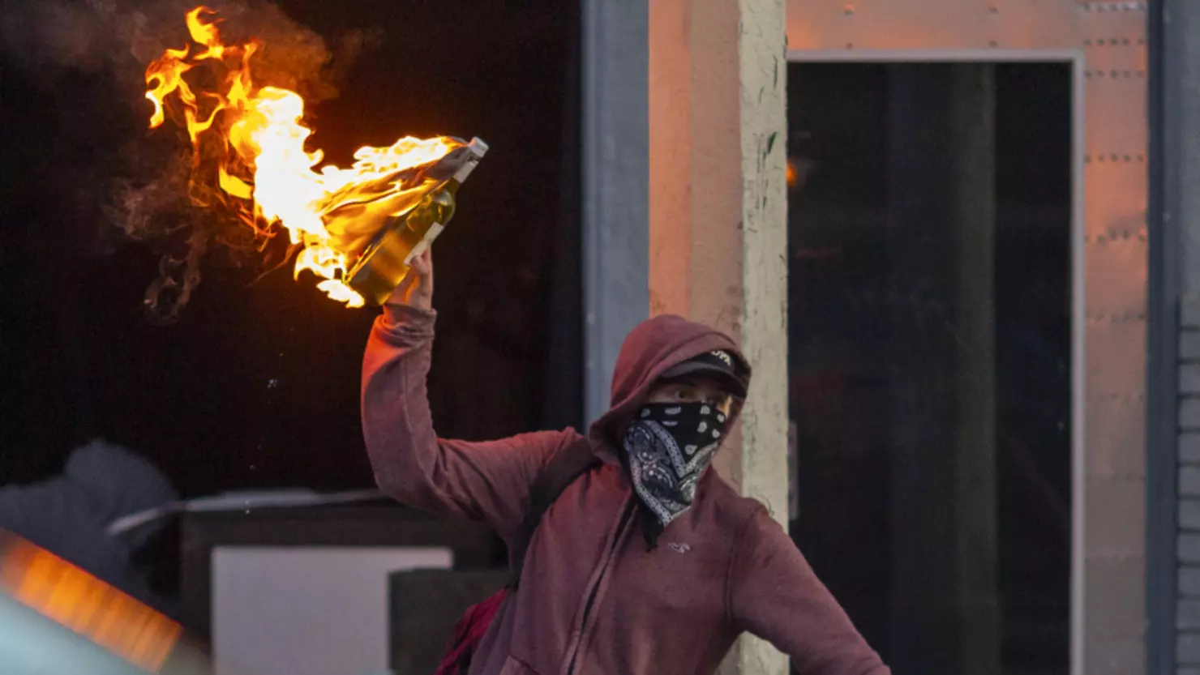
Requirement 4a
Incendiary Fire Cause
When fire results from deliberate acts
The person starting the fire knows he or she should not.
Fires resulting from reckless or negligent acts may be included.
Mindset or mental state (intent) of fire setter is key element of this classification

Slide 37
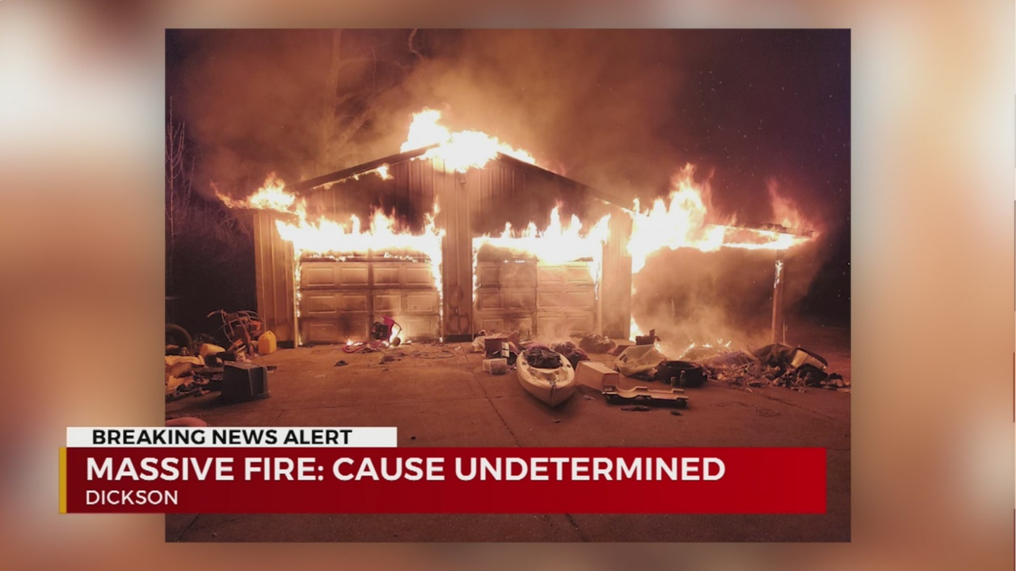
Requirement 4a
Undetermined Fire Cause
Appropriate category for:
Fire not yet investigated.
Fire under investigation.
Investigated fire whose cause is not proven to an acceptable level of certainty.

Slide 38
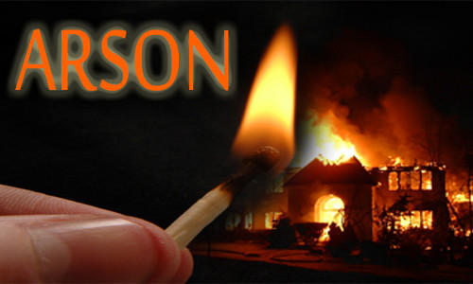
Requirement 4b
Arson is the crime of purposely setting a fire for wrongdoing.
About one in four fires in the U.S. is caused by arson.
Arson is the second leading cause of death by fire.
Arson is a felony that is punishable with a lengthy jail sentence. If a fire set by an arsonist results in death, the arsonist is guilty of murder.
Most arsonists are under the age of 20.
Some youth start fires because they are bored or curious and do not respect or understand fire and the damage it can do.
Others start fires because they are frustrated with some part of their lives and need counseling to address personal issues before they make their life worse.

Slide 39
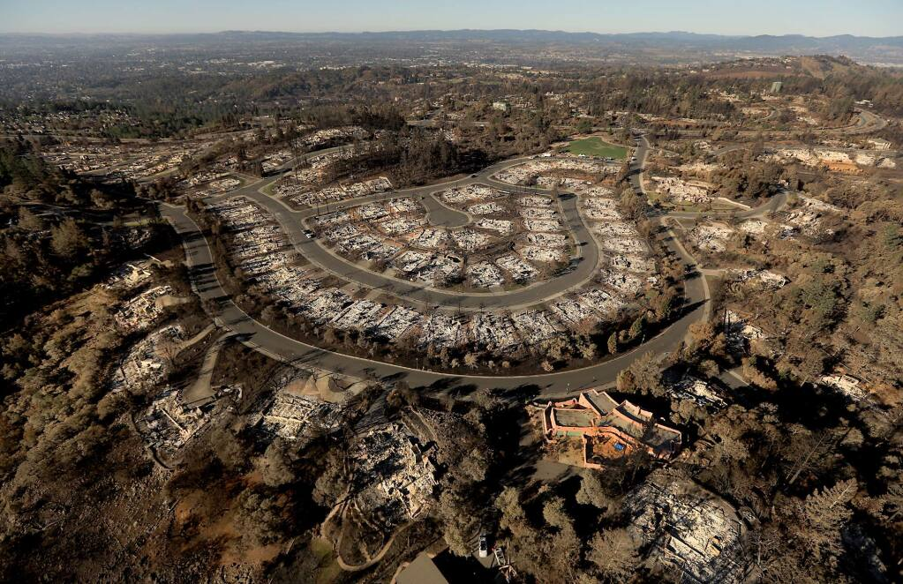
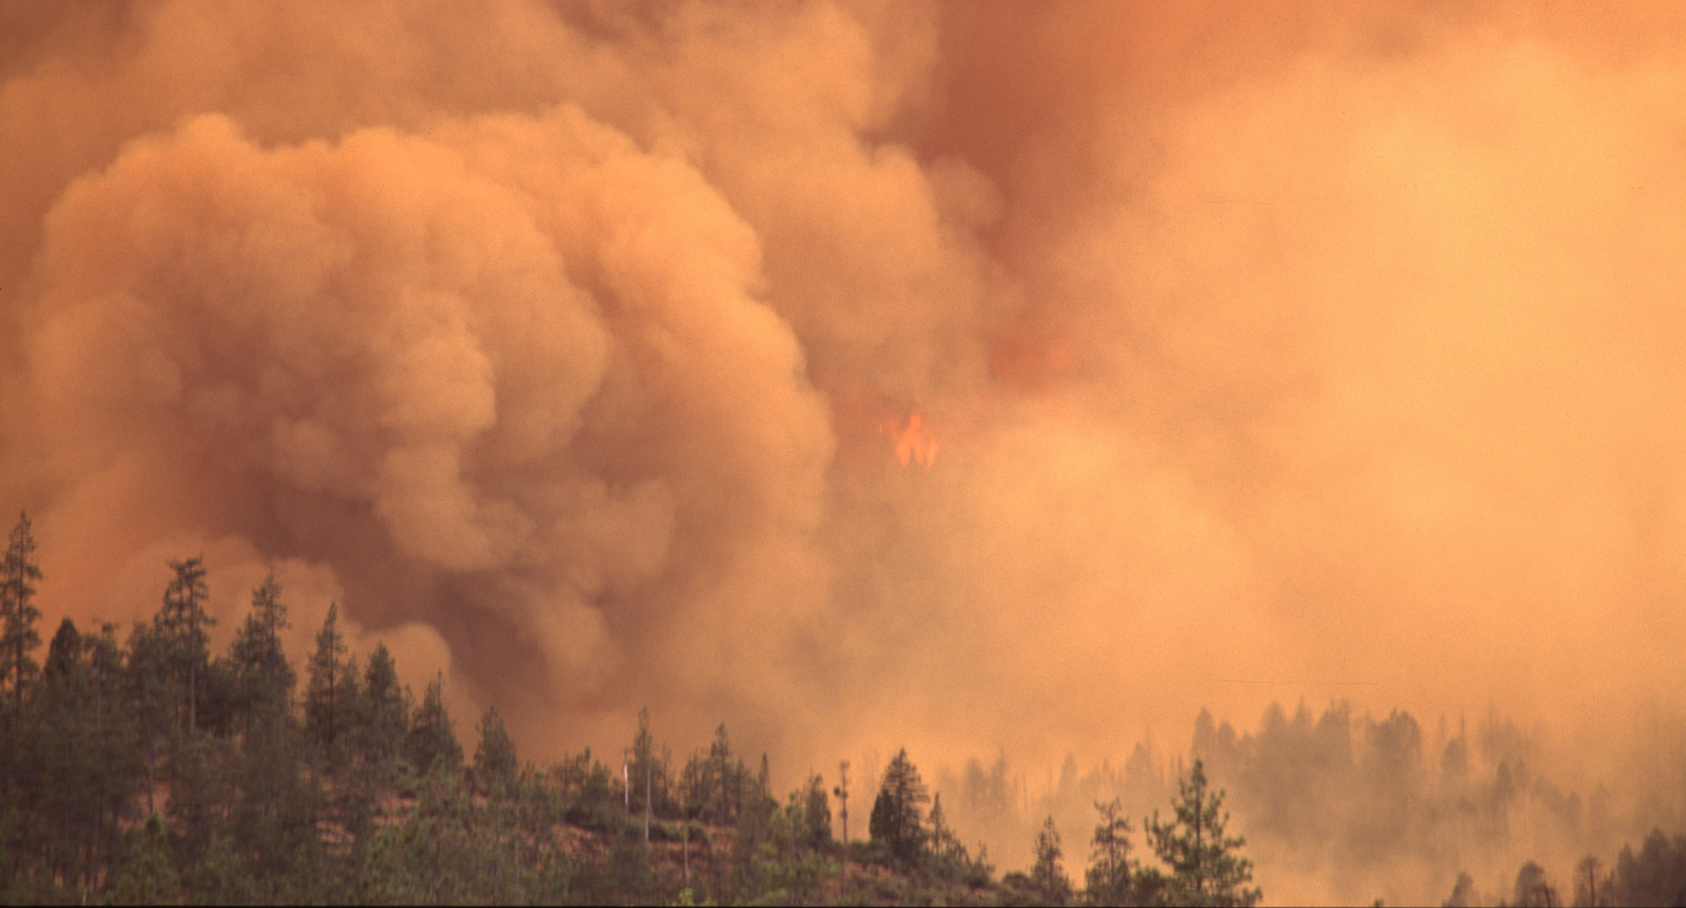
Requirement 4c
Social, economic and environmental consequences of arson include:
Loss of lives
Destroys needed buildings
Increases insurance premiums
Loss of business revenue
Decrease in property values.
Damage to ecosystems
Increased soil erosion
Increased air pollution

Slide 40
Requirement 5
List the actions and common circumstances that cause seasonal and holiday-related fires. Explain how these fires can be prevented.

Slide 41
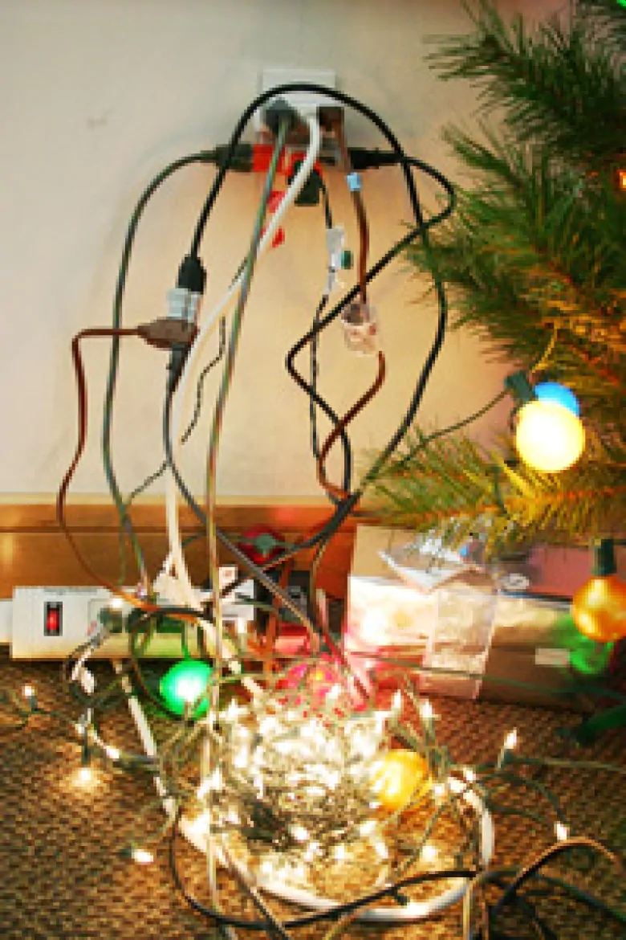
Requirement 5
Seasonal and Holiday-Related Fires
Inspect electrical decorations for damage before use.
Cracked or damaged sockets, loose or bare wires, and loose connections may cause a serious shock or start a fire.
Do not overload electrical outlets.
Overloaded electrical outlets and faulty wires are a common cause of holiday fires. Avoid overloading outlets and plug only one high-wattage into each outlet at a time.
Never connect more than three strings of incandescent lights.
More than three strands may not only blow a fuse, but can also cause a fire.

Slide 42
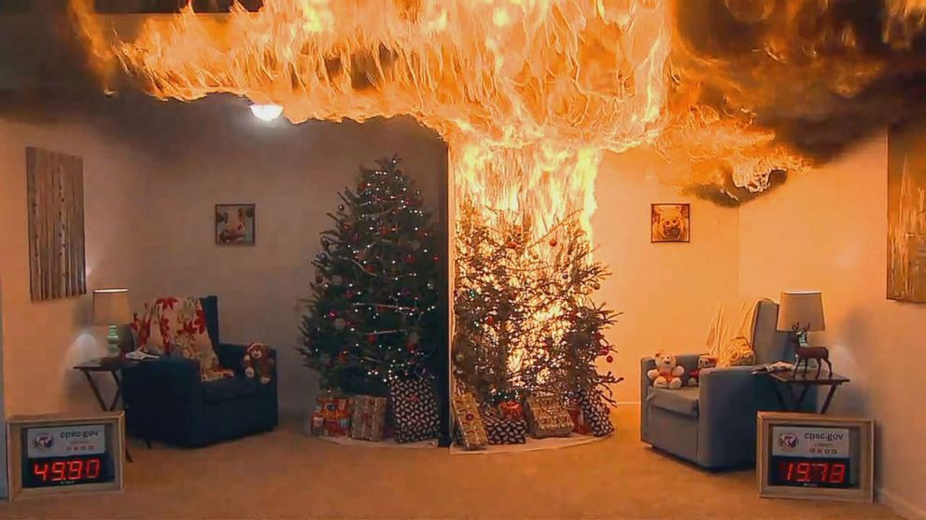
Requirement 5
Seasonal and Holiday-Related Fires
Keep trees fresh by watering daily.
Dry trees are a serious fire hazard.
Watered
Dry

Slide 43
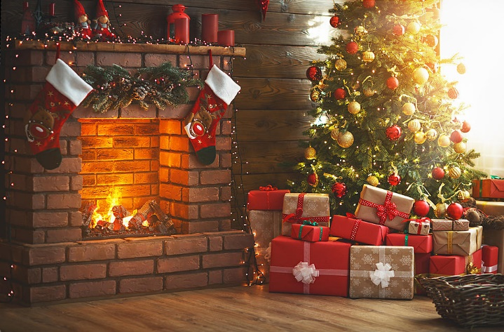
Requirement 5
Seasonal and Holiday-Related Fires
Use battery-operated candles.
Candles start almost half of home decoration fires (NFPA).
Keep combustibles at least three feet from heat sources.
A heat sources that was too close to the decoration was a factor in half of home fires that began with decorations (NFPA).
Protect cords from damage.
To avoid shock or fire hazards, cords should never be pinched by furniture, forced into small spaces such as doors and windows, placed under rugs, located near heat sources, or attached by nails or staples.

Slide 44
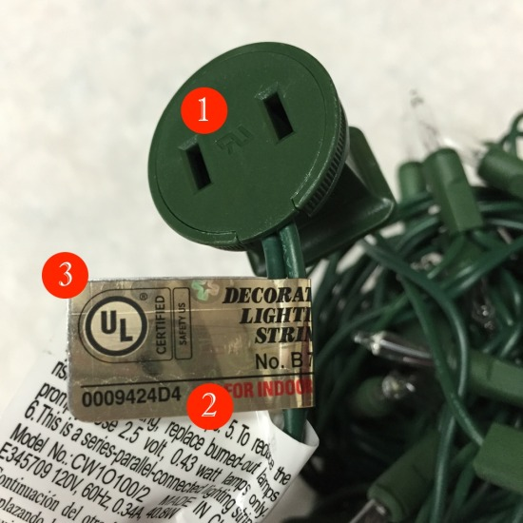
Requirement 5
Seasonal and Holiday-Related Fires
Check decorations for certification label.
Decorations not bearing a label from an independent testing laboratory such as Underwriters Laboratories (UL) have not been tested for safety and could be hazardous.
Stay in the kitchen when something is cooking.
Unattended cooking equipment is the leading cause of home cooking fires (NFPA).
Turn off, unplug, and extinguish all decorations when going to sleep or leaving the house.
Unattended candles are the cause of one in five home candle fires. Half of home fire deaths occur between the hours of 11pm and 7am (NFPA).
UL Recognized Component Mark.
Holographic UL Label.
New enhanced UL Logo.

Slide 45
Requirement 6
Conduct a home safety survey with the help of an adult. Then do the following:
Draw a home fire-escape plan, create a home fire-drill schedule, and conduct a home fire drill.
Identify the location of all smoke alarms in your home and confirm that none are more than 10 years old. Test each smoke alarm and demonstrate regular maintenance of a smoke alarm.
Explain what to do when you smell natural gas and when you smell smoke.
Explain how you would report a fire to have the fire department respond.
Explain what fire safety equipment can be found in public buildings.
Explain who should use fire extinguishers and when these devices can be used.
Explain how to extinguish a stovetop pan fire.
Explain what fire safety precautions you should take when you are in a public building.

Slide 46
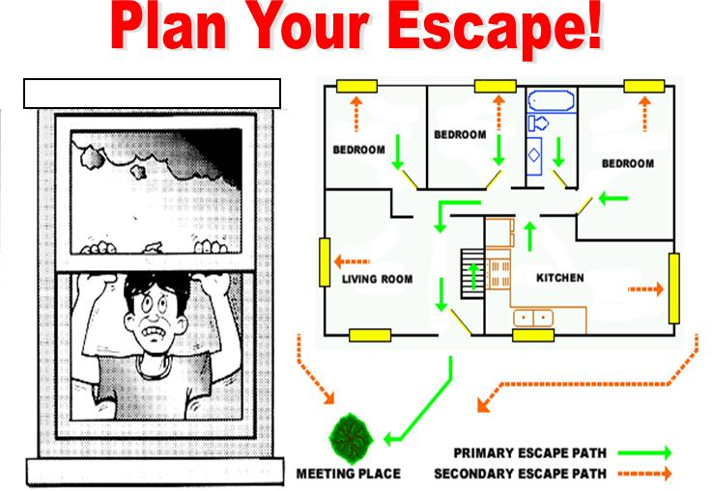
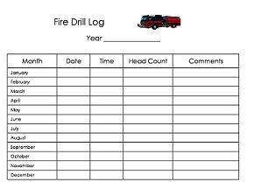
Requirement 6a
Draw a home fire-escape plan, create a home fire-drill schedule, and conduct a home fire drill.

Slide 47
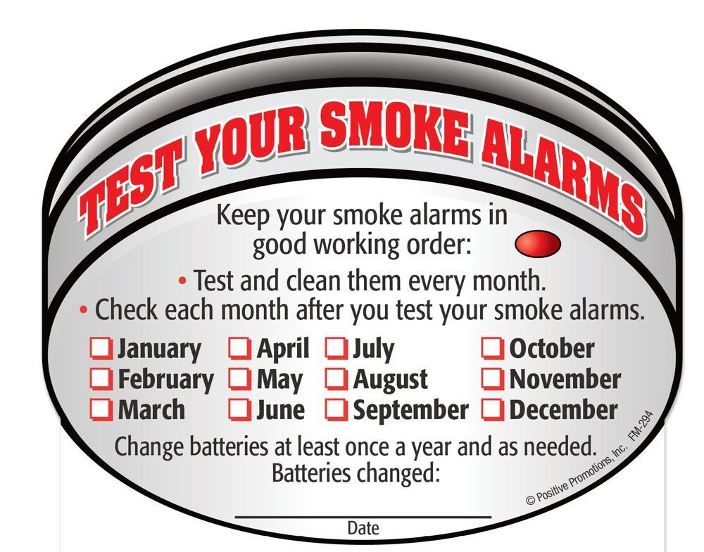
Requirement 6b
Test a smoke alarm and demonstrate regular maintenance of a smoke alarm.

Slide 48
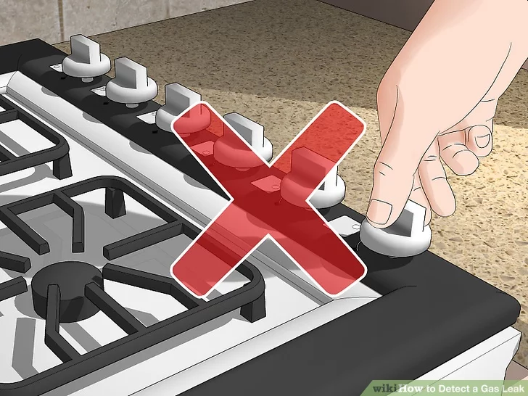
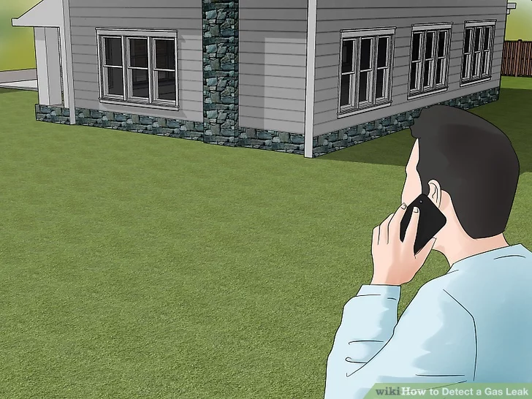
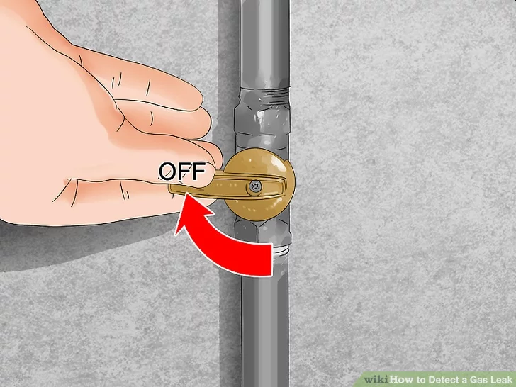
Requirement 6c
What to do if you smell natural gas:
Put out any open flames immediately and don't use anything capable of creating sparks or electrical charges. This includes devices like light switches, thermostats and doorbells. These sources can produce sparks or flames that may start a fire or trigger an explosion.
If you detect the presence of gas, you and your family should leave the house immediately. If you smell natural gas outside, you should evacuate the area. Get a safe distance away from the leak and don't try to fix or troubleshoot the issue yourself.
If safe, shut off your main gas supply valve. To shut the valve, just turn it clockwise.
Whether it be from your neighbor's home or another building nearby, immediately contact your gas company. If you can't reach them, call 911.
Don't return to the area until your emergency responder, gas company or service technician says it's safe to.
Before attempting to use your gas appliances, your service technician or propane provider will need to inspect your system to confirm that it's 100% leak-free.

Slide 49
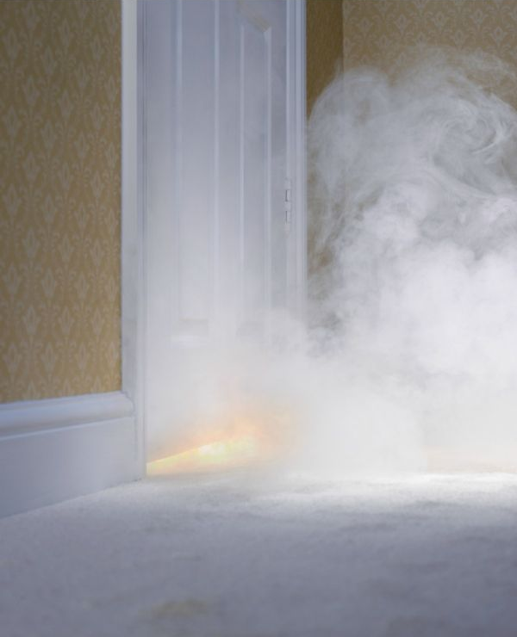
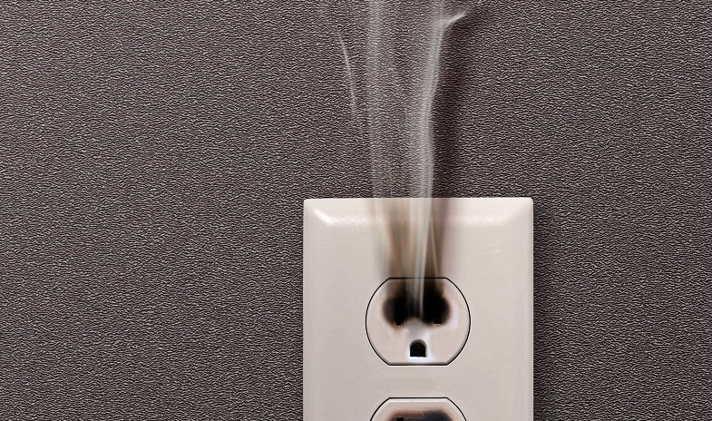
Requirement 6c
What to do if you smell smoke:
First, protect yourself and your family. Quickly search for the smoke source and get out of the house or building if fire is present, particularly if it is large and/or uncontained. Get others out as well.
Call 911 from a cell phone or a neighbor's house rather than stay inside a burning building.

Slide 50
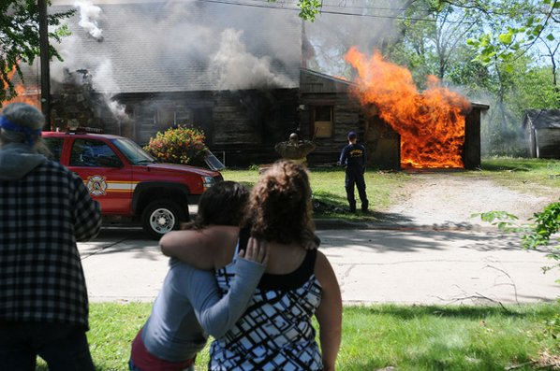
Requirement 6d
If you discover a fire or smoke condition:
Do not panic.
If the fire is in a room or small area, confine the spread of the smoke and fire by closing the room doors prior to leaving the building, but only if it is safe to do so.
Evacuate the building to the outside and warn others of the fire on the way out.
Once you have reached a safe area, call 911.
Never re-enter the building.
Seek out the first arriving personnel, police officer, fire fighter, EMT, and give them the specific location of the fire or smoke.
If you know someone is still inside, try to give the fire fighters the last known location where you saw them.

Slide 51
Requirement 6e
Fire safety standards for public buildings include:
Fire extinguishers
Fire alarms
Sprinkler systems
Fire escapes
Having clearly marked exits in crowded public venues like movie theatres and shopping malls.

Slide 52
Requirement 6f
Fire extinguishers can be beneficial if they are controlled by someone who knows how and when to use them.
Know where the fire extinguishers are located.
Practice using them correctly (PASS Method). The moment you face a fire is not the time to learn how to use the extinguisher.
Using a fire extinguisher calls for quick and sensible judgement. A small, contained fire can usually be controlled by an extinguisher.
Do not waste valuable time using an extinguisher on a fire that is too large to put out.
Instead, sound the alarm and get out
Remember, if a fire is serious enough to require a fire extinguisher, it is serious enough to sound the alarm and call the fire department first.

Slide 53
Requirement 6f
There are 5 classes of fire extinguishers – A, B, C, D, and K – and each class can put out a different type of fire.
Class A extinguishers will put out fires in ordinary combustibles such as wood and paper.
Class B extinguishers are for use on flammable liquids like grease, gasoline and oil.
Class C extinguishers are suitable for use only on electrically energized fires.
Class D extinguishers are designed for use on flammable metals.
Class K extinguishers are used on fires involving cooking media (fats, grease, and oils) in commercial cooking sites such as restaurants.

Slide 54
Requirement 6f

Slide 55
Requirement 6g
If a grease fire starts:
Cover the flames with a metal lid or cookie sheet.
Turn off the heat source.
If it's small and manageable, pour baking soda or salt on it to smother the fire.
As a last resort, spray the fire with a Class B dry chemical fire extinguisher.
Do not try to extinguish the fire with water.

Slide 56
Requirement 6h
Fire Safety in Public Buildings
Before you enter:
Take a good look. Does the building appear to be in a condition that makes you feel safe? Is the main entrance wide, and does it open outward to allow easy exit?
Is the outside area clear of materials stored against the building or blocking exits?
Have a communication plan. Identify a relative or friend to contact in case you are separated from family or friends in an emergency.
Plan a meeting place outside to meet family or friends with whom you are attending the function. If there is an emergency, be sure to meet them there.

Slide 57
Requirement 6h
Fire Safety in Public Buildings
When you enter:
When you enter a building, make sure to identify all available exits. Some exits may be in front and some in back of you.
Be prepared to use your closest exit. You may not be able to use the main exit.

Slide 58
Requirement 6h
Fire Safety in Public Buildings
During an Emergency:
If an alarm sounds, you see smoke or fire, or other unusual disturbance, immediately exit the building in an orderly fashion.
When evacuating the building, be sure to feel doors for heat before opening them to be sure there is no fire danger on the other side.
If there is smoke in the air, stay low to the ground, especially your head, to reduce inhalation exposure.
Keep on hand on the wall to prevent disorientation and crawl to the nearest exit.
Once you have escaped, stay out. Under no circumstances should you ever go back into a burning building. Let trained firefighters conduct rescue operations.

Slide 59
Requirement 7
Do the following:
Demonstrate lighting a match safely, the proper way to extinguish it and to dispose of it.
Demonstrate the safe way to start a charcoal fire.
Demonstrate how to safely light a candle. Discuss with your counselor how to safely use candles.

Slide 60
Requirement 7a
Lighting a match safely.
Hold the safety match with your dominant hand.
Hold the match box in your non-dominant hand.
Swiftly strike the head of the match against the side of the match box. Important: Strike in the direction away from your body, so the fire ignites and starts away from you, not towards you.

Slide 61
Requirement 7a
Extinguishing and disposing of a match.
Wet them before disposing of them.
Then throw the soaked matches in the garbage bin.

Slide 62
Requirement 7b
Demonstrate the safe way to start a charcoal fire.
Step 1: Fill the chimney with the appropriate amount of charcoal.
Step 2: Add one or two sheets of newspaper, following the instructions on the chimney. Light the newspaper in several spots.
Step 3: After about 10 minutes, you will see the coals starting to glow through the vents and flames starting to flicker over the top layer of coals. Pour them out into a pile and wait until the coals are mostly covered in ash and gray in color. Then spread the coals out. The entire process takes approximately 15 minutes.

Slide 63
Requirement 7b
Demonstrate the safe way to start a charcoal fire.
Step 1: Arrange the coals into a neat mound. Piling the coals into a mound or pyramid will help increase coal-to-coal contact and help the fire spread.
Step 2: Carefully squirt lighter fluid on the top and sides of the charcoal mound, following lighter fluid directions. Light immediately after applying the fluid. Never squirt lighter fluid onto flaming or hot coals.
Step 3: After the fluid burns off, the edges of the coals will turn gray. As the coals continue to burn, the ash spreads to cover each briquette. Once mostly covered in ash, the coals are ready to spread out and use. The entire process takes approximately 15 minutes.

Slide 64
Requirement 7c
How to Burn a Candle Safely
Before lighting:
Before burning, always trim the wick to ¼ inch. Long or crooked wicks can cause uneven burning, dripping or flaring.
Always use a candleholder specifically designed for candle use. It should be heat resistant, sturdy, and large enough to contain any drips or melted wax.
Burn candles in a well-ventilated room:
It is recommended that candles do not burn for longer than four hours and cool for at least two hours before relighting.
When lighting a candle, use long matches or a long-reach lighter. Keep your hair and loose clothing away from the flame.

Slide 65
Requirement 7c
How to Burn a Candle Safely
While burning:
Never leave a candle unattended.
Never burn a candle on or near anything that can catch fire.
Keep candles out of the reach of children and pets.
Keep your candle stationary. Never move or touch the candle once the flame is ignited or when the wax is liquefied. Extinguish a candle if the flame becomes too high or flickers repeatedly. Let the candle cool, trim the wick, and check for unwanted drafts before re-lighting.
Never use a candle as a night light or while you may fall asleep.
Be very careful if using candles during a power outage. Flashlights and other battery-powered lights are safer sources of light during a power failure. Never use a candle during a power outage to look for things in a closet, or when fueling equipment – such as a lantern or kerosene heater.

Slide 66
Requirement 7c
How to Burn a Candle Safely
When extinguishing a candle:
Use a candle snuffer to extinguish a candle. It’s the safest way to prevent hot wax from splattering.
Make sure the candle is completely out and the wick ember is no longer glowing before leaving the room.
Don’t touch or move the candle until it has completely cooled.

Slide 67
Requirement 8
Explain the difference between combustible and noncombustible liquids and between combustible and noncombustible fabrics.

Slide 68
Requirement 8
Flammable Liquids
Flammable liquids are different from other liquids because less heat is required for them to vaporize. These vapors are combustible under ordinary temperatures.
Whenever a container of flammable liquid is open, vapors are escaping and a fire is possible.
When vapor escapes from a flammable liquid, it mixes with air. This vapor-air mixture provides two of the three necessary ingredients for fire, fuel and oxygen. All that is necessary for combustion to occur is the right amount of heat.
Without proper ventilation, vapor levels can quickly build up and become dangerous. Vapor is invisible. It can travel from floor to floor in a house and to an ignition source that is incorrectly considered a safe distance away. A dangerous concentration of vapor might be present without your knowledge.

Slide 69
Requirement 8
Combustible and Noncombustible Fabrics.
Synthetic materials are slower to ignite than natural ones, but once they catch fire, they melt and can cause serious burns.
Synthetic and natural materials can be treated with substances that will inhibit their ability to ignite or continue burning.
Fiberglass materials and special fire-resistant fabrics do not burn because their chemical makeup will not allow ignition.
Federal laws regulate the flame resistance of children’s sleepwear, mattresses, carpets, upholstery, and some camping equipment.

Slide 70
Requirement 8
Combustible and Noncombustible Fabrics.
When determining the relative flammability of fabrics, consider these factors:
Weight – Heavier fabrics are less likely to burn.
Weave – Dense fabrics are less likely to burn than more open fabrics.
Construction – The smoother the surface, the less likely it is to burn.
Style – Loose-fitting garments can ignite more easily than tight-fitting ones.

Slide 71
Requirement 9
Do the following:
Describe for your counselor the safe way to refuel a liquid fueled engine, such as a lawn mower, weed eater, outboard motor, farm machine, or automobile with fuel from an approved gasoline container.
Demonstrate the safety factors, such as proper ventilation, for auxiliary heating devices and the proper way to fuel those devices.

Slide 72
Requirement 9a
How to refuel a liquid fuel engine safely.
Store gasoline in a container with a UL, FM, or CSA label.
Never smoke when filling a gas tank.
Always make sure to shut off your engine and allow it to cool down before adding more gas.
It is important to use a funnel when refueling your mower to avoid spilling gasoline.
Wipe up gasoline spills immediately and do not attempt to start the engine. Move the machine away from the area of spillage and avoid creating any source of ignition until fuel vapors have dissipated.
Never over-fill the fuel tank. Replace gas cap and tighten securely.
Never remove the gas cap or add fuel with the engine running. Allow the engine to cool, before refueling.

Slide 73
Requirement 9b
Auxiliary Heaters, used improperly can cause fires, burns and carbon monoxide poisoning.
Have a three-foot “kid- and pet-free” zone around the auxiliary heaters, and keep combustibles out of this region.
Install and maintain carbon monoxide alarms in your home.
Electric space heaters
Turn heaters off when you go to bed or leave the room.
Only use heaters that shut off automatically if tipped over.
Place space heaters on a solid, flat non-combustible surface.
Don’t use extension cords.
Replace cracked or damaged plugs or power cords.

Slide 74
Requirement 9b
Auxiliary Heaters, used improperly can cause fires, burns and carbon monoxide poisoning.
Fuel-burning heaters
Only use the fuel specified by the manufacturer.
Only use heaters with an emergency shut off.
Do not put heaters on rugs or carpets.
Only use heaters designed for indoor use.
Always follow the manufacturer's directions for proper use.
Only use heaters with oxygen sensors.

Slide 75
Requirement 9b
To refuel your fuel-burning heater or stove, there are a few simple guidelines to make it much safer.
You should always fill up outdoors. You can do this by removing a cartridge tank or by taking the entire appliance outside. You don't want to accidentally spill fuel inside the home.
Make sure that the heater or stove has cooled down completely. You should never attempt to fill a hot stove or heater.
Make sure that you put the cap back on securely.
Don't ever carry the stove or heater while it is lit or still hot.

Slide 76
Requirement 9b
Auxiliary Heaters, used improperly can cause fires, burns and carbon monoxide poisoning.
Wood-burning stoves
Make sure there is enough clearance between the stove and combustible materials, including floors, walls and ceilings.
Place the stove on a noncombustible, fire resistant base.
Burn only dry, well-seasoned wood.
Consider opening a window a crack for ventilation.
Dispose of ashes in a closed metal container outside the house.
Clean and inspect chimneys and vents annually.

Slide 77
Requirement 10
Do the following:
Explain the costs associated with outdoor and wildland fires and how they can be prevented.
Demonstrate setting up and putting out a cooking fire.
Demonstrate using a camp stove and lantern.
Explain how to set up a campsite safe from fire.

Slide 78
Requirement 10a
The Cost of Outdoor and Wildland Fires
Death and personal injury are the overriding concerns of outdoor fires.
Wildland fires can damage buildings, timber crops, wildlife and their habitat, and soil
The cost of putting out wildfires is significant.
Businesses destroyed by fire results in lost jobs, tax revenues, and increases social service expenses.
Five Rules of Wildfire Prevention:
Only you can prevent wildfires.
Always be careful with fire.
Never play with matches or lighters.
Always watch your campfire.
Make sure your campfire is completely out before leaving it.

Slide 79
Requirement 10b
Setting up a campfire
Campfires should be built only in safe places on sand or other mineral soil or rocks and never next to trees.
All flammable materials should be cleared away at least 10 feet around the fire.
The fire should never be left unattended.
A campfire can become a danger unless it is kept small. The sparks from a large fire can be carried a considerable distance by a light wind or gust.
Two ways of putting out a campfire
Sprinkle water on the fire. Use a stick to stir the wood and coals, and sprinkle again. Continue this procedure until all the coals are cold-out. Use the back of your bare hand to check for heat.
If water is not available, spread the wood and coals and scrape out the embers with a piece of wood. When the embers are out and none are smoking, cover the entire fire with dirt.

Slide 80
Requirement 10c
Using a camp stove
Use camp stoves and their fuels only with adult supervision. Practice using them before an outing and follow the manufacturer’s directions.
Place stoves on a level surface in ventilated areas only.
Do not overload the stovetop and keep pan lids handy to smother a grease fire if necessary.
Keep fuel in well-marked and approved containers.
Always fuel a stove outdoors.
Allow a hot stove to cool before changing cylinders or refueling.
Using a lantern
Read and follow instructions.
Keep lantern in proper working condition.
Only use lanterns outdoors and never in a tent.

Slide 81
Requirement 10d
How to set up a campsite safe from fire.
Make sure to have some type of alarm that can be clearly heard throughout the camp if a fire breaks out.
Remove all flammable rubbish and leaves from around the tents, stoves, and campfires.
Hang towels and clothes to dry away from stoves and campfires.
Make a nightly check of the camp before going to bed to see that all fires and lights are out.

Slide 82
Requirement 11
Visit a fire station. Identify the various types of fire trucks and describe the functions of each. Find out about the fire prevention activities in your community during your visit.

Slide 83
Requirement 11
Quint Fire Truck
A quintuple combination pumper or “quint” is a fire apparatus that serves as both an engine and a ladder truck.
There are five functions that a quint provides: pump, water tank, fire hose, aerial device, and ground ladders.
These types of fire trucks are useful for smaller departments that must protect a combination of single-family homes and low to medium-rise buildings.

Slide 84
Requirement 11
Tiller Fire Truck
Large metro communities usually employ tiller aerial ladder trucks. These types of fire trucks work better in urban areas.

Slide 85
Requirement 11
Structure Engines: Type 1 and 2
Structure engines are the apparatus primarily designed for structural firefighting.
Commonly found on these engines are Self Contained Breathing Apparatus, chainsaws and circular saws, as well as many different types of specialized equipment.

Slide 86
Requirement 11
Wildland Engines: Type 3 and 4
A wildland fire engine is one that is specifically designed to assist in fighting wildfires by transporting firefighters to the scene and providing them with access to water and other equipment.

Slide 87
Requirement 11
Wildland Engines: Type 5,6, & 7
Types 5-7 are the smallest for navigating rough wildland terrain.

Slide 88
Requirement 11
Visit a fire station and find out about the fire prevention activities in your community.

Slide 89
Requirement 12
Determine if smoke detectors are required in all dwellings within your municipality. If so, explain which specific types are required. Tell your counselor what type of smoke detectors your house has or needs.

Slide 90
Requirement 12
Smoke alarms are legally required to be present inside every bedroom or room in which someone sleeps.
An additional alarm must be present in the area directly adjacent to the sleeping areas.
One smoke detector must be present on every floor of the house, including basements and attics.
Where multiple smoke alarms are required, the units must be wired together so all of the alarms go off at the same time.
Code requirements mandate that smoke alarms must be hard-wired directly into the home’s electrical system and provided with a backup battery to keep the unit functioning during a power failure.
Alarms are required to beep or otherwise indicate when the backup battery’s power is low.
Smoke alarms powered by batteries alone are allowed if the home was built before building codes required hard-wired units.

Slide 91
Requirement 12
What type of smoke detectors does your house have or need?

Slide 92
Requirement 13
Choose a fire safety-related career that interests you and describe the level of education required and responsibilities of a person in that position. Tell why this position interests you.

Slide 93
Requirement 13
Firefighters
While putting out fires is their main responsibility, firefighters are often dispatched to accident scenes as well. They perform rescues and emergency medical procedures. Some firefighters specialize in cleaning up at accidents involving hazardous material, while others concentrate on fighting forest fires. Organizations employing firefighters include airports, governments of cities and towns, industrial sites and chemical facilities. The median salary for firefighters was $49,620 per year as of 2018.
Job Requirements
To attain most firefighting jobs, candidates must have a high school diploma (or its equivalent) and pass written and physical tests. To prepare, individuals can take fire science classes through certificate or degree programs. Once hired, firefighters complete training at fire academies before going on the job. Often, they're also required to become certified emergency medical technicians or paramedics. Promotions to positions such as lieutenant, battalion chief or chief require years of experience and high performance levels on written tests. Those who become a battalion chief or higher usually hold a bachelor's degree.

Slide 94
Requirement 13
Fire Inspectors
Fire inspectors make sure public buildings and businesses comply with government fire codes. When there has been a fire, investigators conduct interviews and gather evidence to find its cause. Forest fire inspectors and prevention specialists watch for fires from high towers and alert firefighters when a fire does occur; they monitor the behavior of people traveling through forests to ensure fire safety. In 2018, the median wage for inspectors and investigators was $62,510.
Job Requirements
Experience as a firefighter is necessary to become a fire inspector or investigator. Some employers may require candidates to pursue certification, while others may accept formal academy training. Professional organizations such as the National Fire Protection Association (NFPA) offer designations such as Certified Fire Inspector and Certified Fire Plan Examiner. Forest fire inspectors and prevention specialists often have bachelor's degrees and have gone through apprenticeships for up to 4 years.

Slide 95
Requirement 13
Fire Prevention and Protection Engineers
Fire prevention and protection engineers devise fire detection systems, conduct research and develop fire prevention methodologies. They also consult with architecture and construction personnel to ensure structures comply with fire safety regulations. The median annual salary for these professionals was $89,130 as of 2018.
Job Requirements
The majority of fire prevention and protection engineers have bachelor's degrees; they usually major in engineering. Many states require engineers to become licensed, a process that entails passing exams and accumulating experience. Engineers may wish to pursue the Certified Fire Protection Specialist credential available through the NFPA.

Slide 96
THE END

